Slide 1
Slide Deck for California Hospital Charges Project
Thought process for creating a Database to easily access California hospital charges and all related costs for patient transparency

Slide 2
Contents
Purpose ………………………………………………………………………………….... 2
Background …………………………………………………………………………….... 3
Breakdown of Current Healthcare Costs …………………………………………… 4
Proposed Solution …………………………………………..…………………………... 5
Proposed Solution Overview ………………………………………………………….. 6
Data Exploration ……………………………………………………………………… 7-12
Data Transformation …………………………………………………………………..13-23
Migration to PySpark …………………………………………………………………… 24
Data Pipeline …………………………………………………………………………….. 25
Test Suite …………………………………………..………………………………….... 26-27
Dashboard ………………………………………….…………………………………….. 28

Slide 3
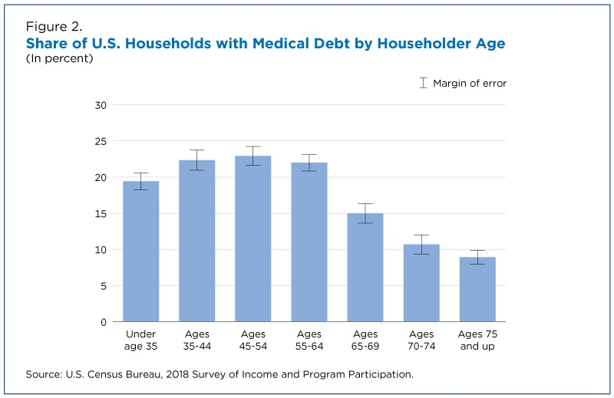
Purpose
“Medical debt is now the No. 1 source of debt collections, surpassing debt in collections from credit cards, utilities, auto loans, and other sources of combined.” - Stanford Institute for Economic Policy Research
Patients have no idea what they will be charged until AFTER their procedure
19% of U.S. households carried medical debt

Slide 4
Background
Every hospital in the US were required to provide a comprehensive price list of common procedures in January 2021
This list of procedure costs are known as Chargemasters
An attempt to make medical costs more transparent
Problems:
Not all hospitals have submitted their chargemasters
Inconsistent format of chargemasters
Chargemasters are not posted easily on hospital websites

Slide 5

Breakdown of Current Healthcare Costs

Slide 6
Proposed Solution
Process submitted chargemasters to be easily read and accessible in a database
Include the following information to enrich database:
hospital profiles (location, license #, etc.)
Current Procedural Terminology (CPT ) descriptions
Accepted insurances per hospital
Cost of in-network vs out-of-pocket expense per procedure per hospital

Slide 7
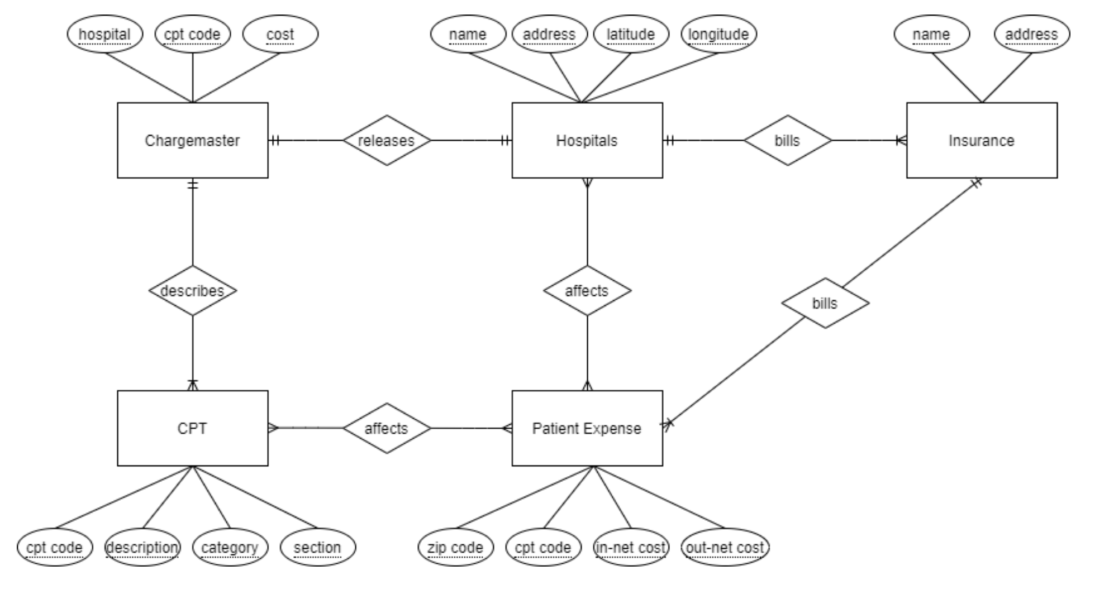
Proposed Solution Overview
1
2
3
4
5

Slide 8

Data Exploration
Explanation of data found

Slide 9
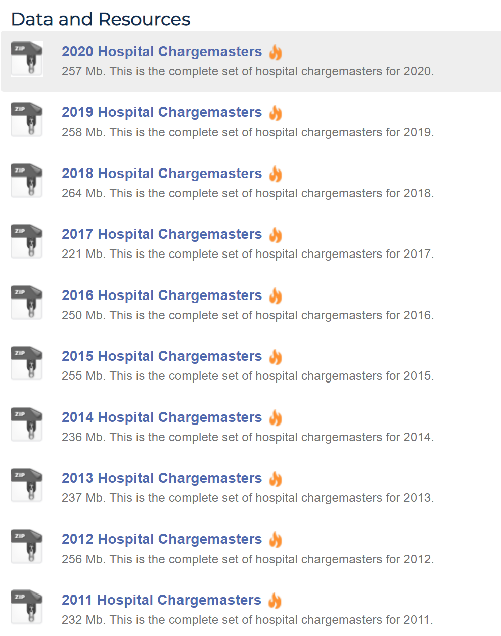
1. Chargemaster Dataset
Downloaded from https://data.chhs.ca.gov/dataset/chargemasters
Currently only California requires chargemasters to be submitted directly to the state
Data taken from California’s Office of Statewide Health Planning and Development (OSHPD)
Organized per year
Each year broken down into individual hospitals
11,000 + files in total

Slide 10
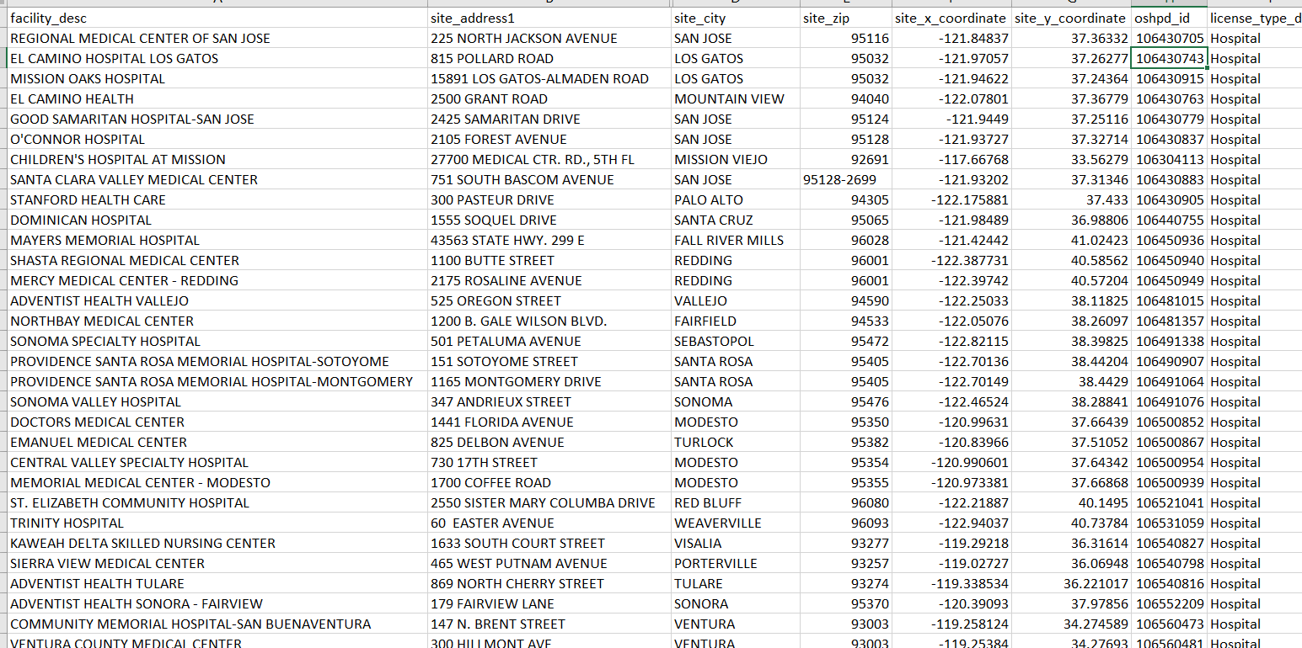
2. Hospital Profile Dataset
Downloaded from https://data.chhs.ca.gov/dataset/facility-profile-attributes
Used to compare nearby hospital costs

Slide 11
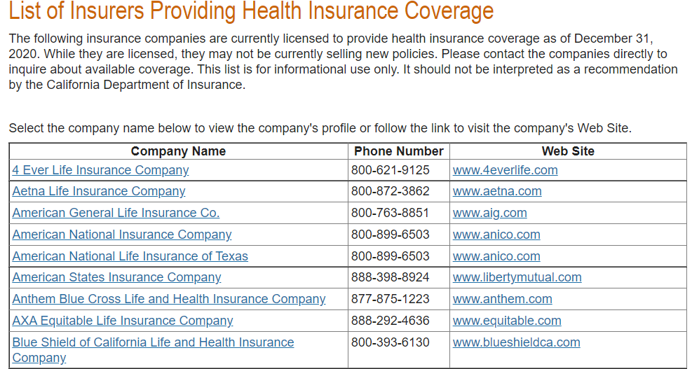
3. Insurance Dataset
Table copied from http://www.insurance.ca.gov/01-consumers/110-health/20-look/hcpcarriers.cfm
List all the valid insurances accepted in California
Will be used to find accepted insurances per hospital (slide 19)

Slide 12
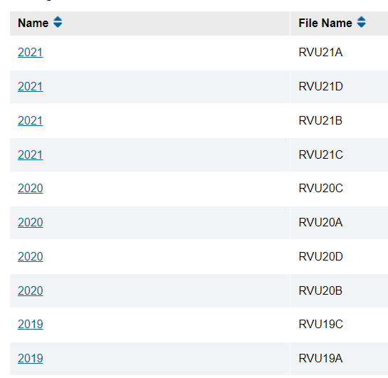
4. CPT Dataset
Downloaded from https://www.cms.gov/Medicare/Medicare-Fee-for-Service-Payment/PhysicianFeeSched/PFS-Relative-Value-Files
Help find procedure codes based on description easier
Use HCPCS datasets
“Level one [HCPCS] is identical to CPT, though technically those codes, when used to bill Medicare or Medicaid, are HCPCS codes” – Medical Billing and Coding

Slide 13
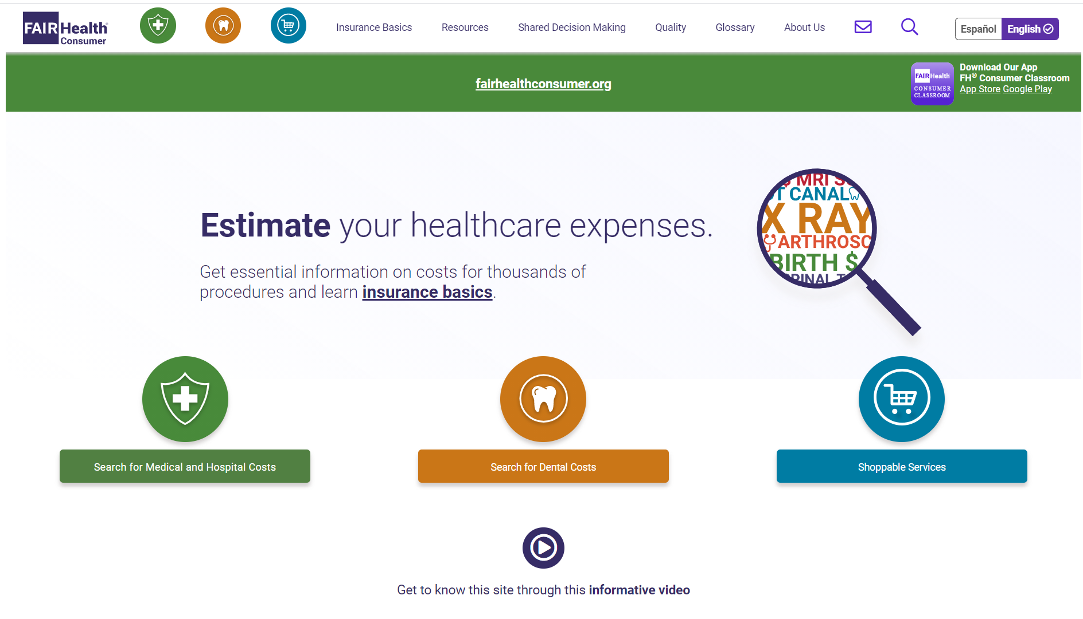
5. Patient Expenses Dataset
Scraped from https://www.fairhealthconsumer.org/
Find the cost of each procedure per hospital based on insurance (in-network vs out-of-network)
Allows to compare prices taking insurance (or no insurance) into account

Slide 14
Data Transformation
Explanation of How Raw Data was transformed into Clean Dataframes

Slide 15
1. Charge Master Dataset
Problems:
Each hospital submitted data under different excel files, sheet names, table formats, etc.
Makes it hard to find the target ‘Common OP Procedures’ table.
Procedure to find target sheet:
Script to extract all target sheets (next slide)
Look through each sheet in every excel file in each hospital folder
Check if known header of target form exist in the sheet
Track excel file path and sheet name that meets criteria.

Slide 16
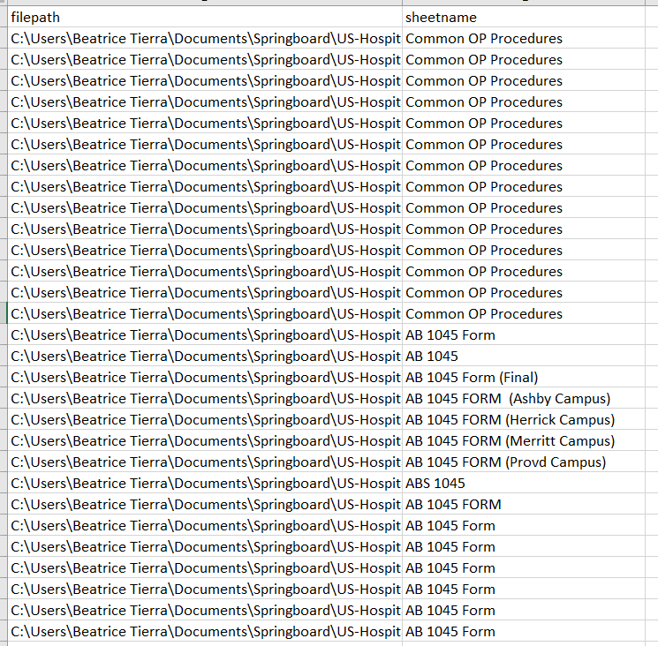
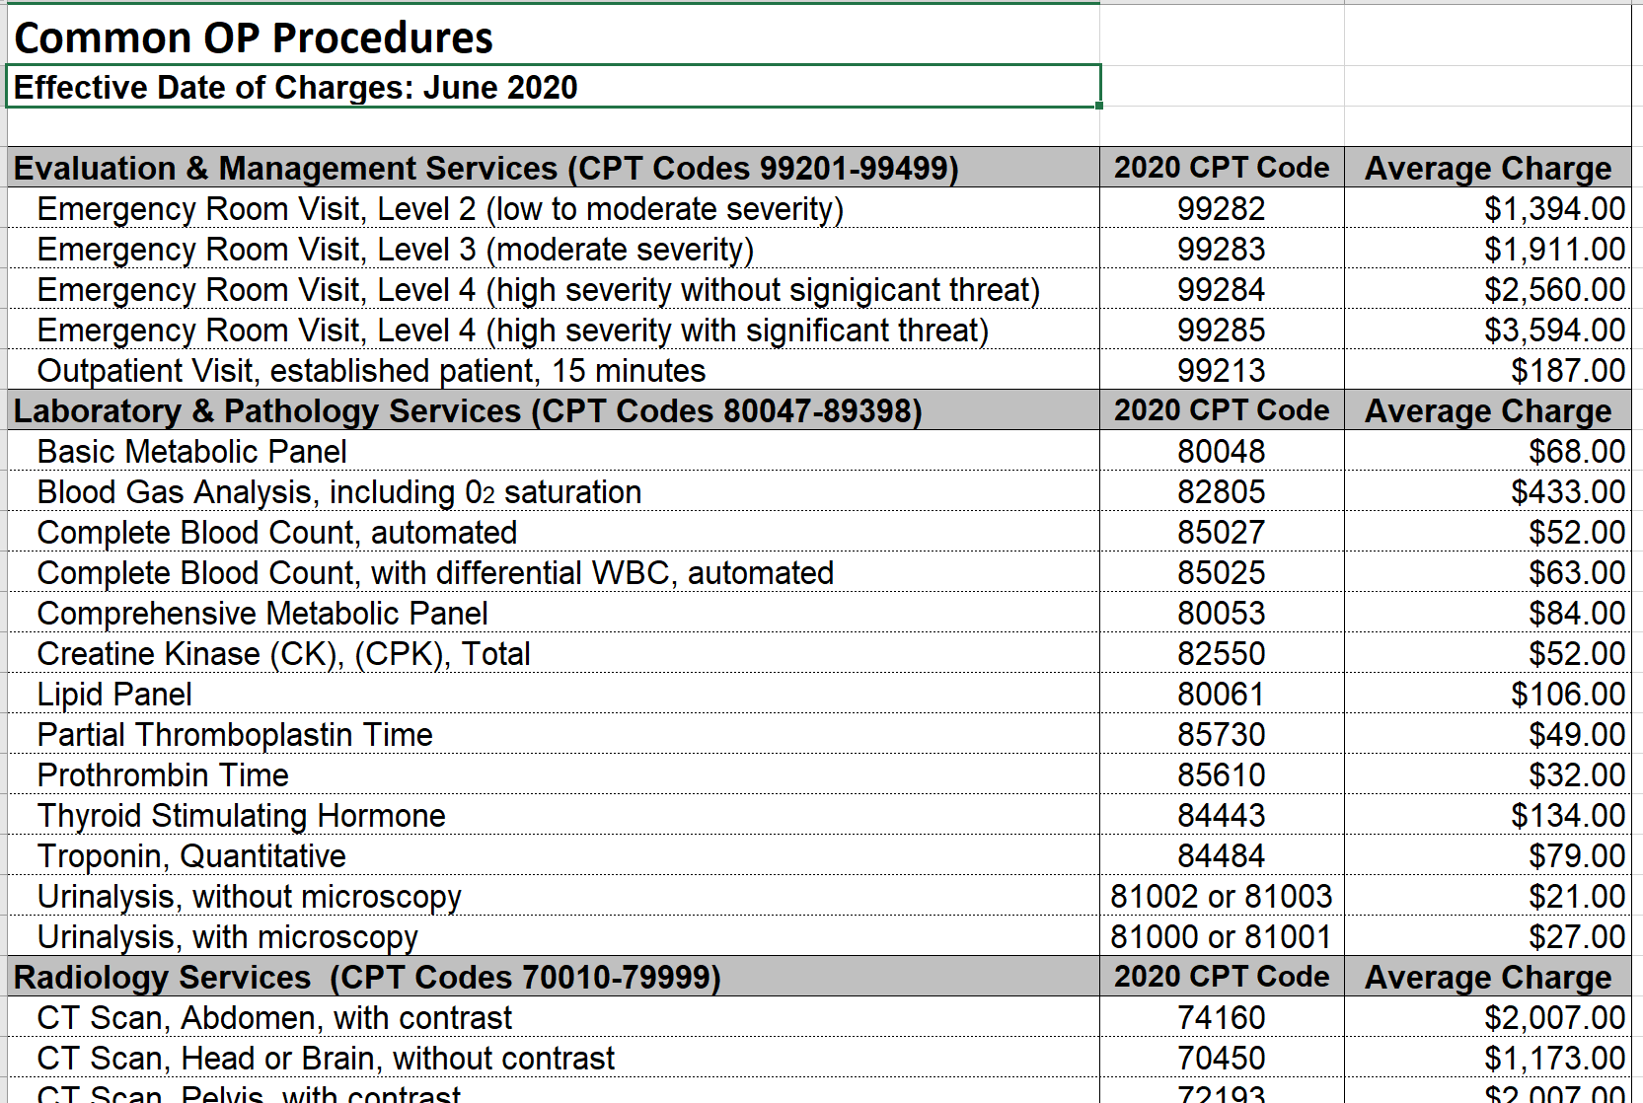
1. Charge Master Dataset (cont.)
Each hospital’s form (raw data)
Found filename and sheet name of target forms

Slide 17
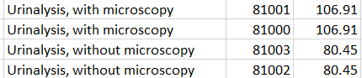

1. Charge Master Dataset (cont.)
After finding all target form locations:
Read each sheet
Extract only rows with valid CPT code
Clean CPT codes
Combine all data frames to include all hospitals.
Final table columns: Hospital, Description, CPT Code, Cost

Slide 18
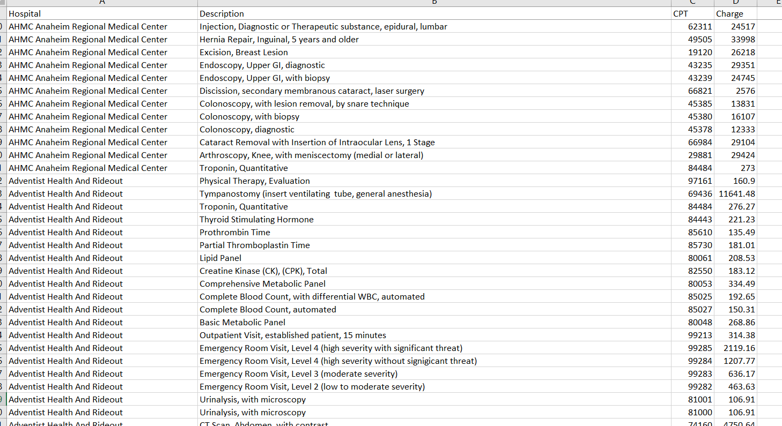
1. Charge Master Dataset (cont.)
Final charge masters dataset

Slide 19
2. Hospital Profile Dataset
Drop unnecessary columns
Final columns: faculty_desc, site_address1, site_address2, site_city, site_zip, site_x_coordinate, site_y_coordinate, oshpd_id, license_type_desc, license_category_desc, license_number

Slide 20
3. Insurance Dataset
Original insurance dataset did not have to transformed
However, insurance data was used to find another dataset -> Accepted Insurances
Find which hospital accepts which insurances
Took insurance names (slide 10) and hospital names slide (18)
Used Selenium to run the following procedure:
1. Google [hospital name] + ‘accepted insurances’
Example: Google searched “Kaiser Permanente accepted insurances”
2. Click first search result
3. Loop through list of insurances names and check if found on selected page

Slide 21
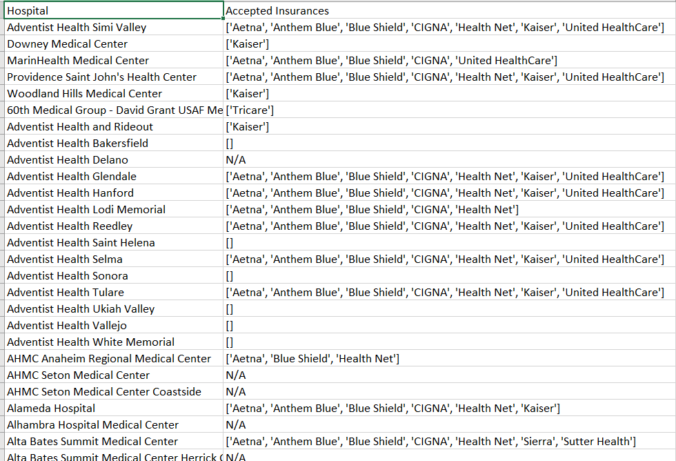
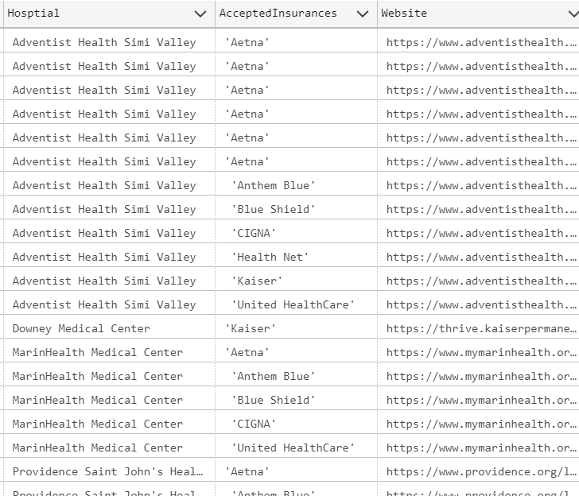
3. Insurance Dataset (cont.)
Scraped data
Cleaned data

Slide 22
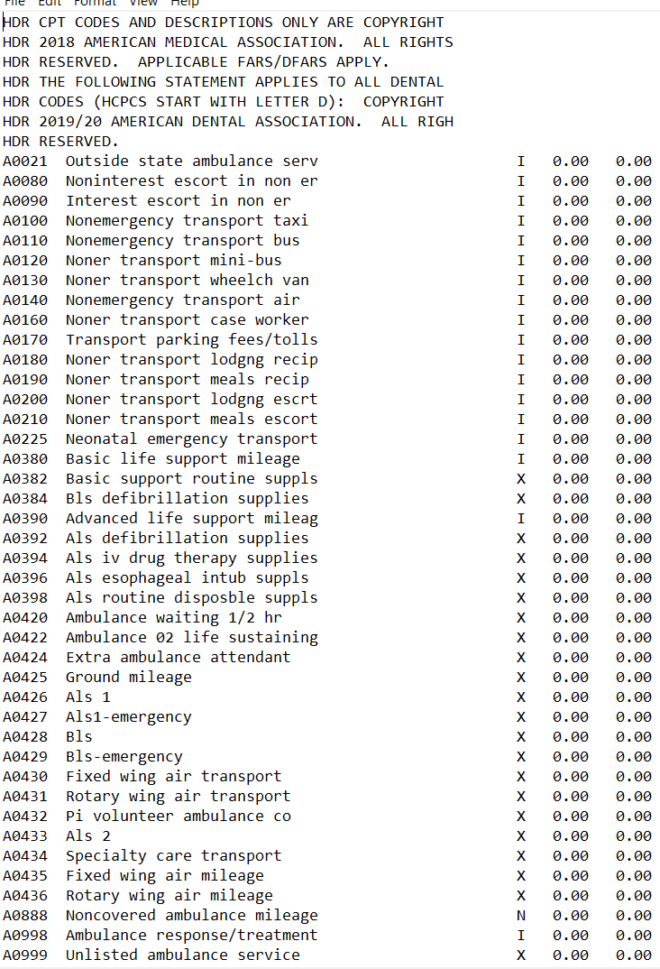
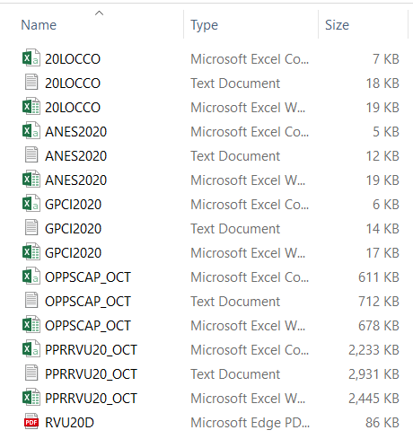
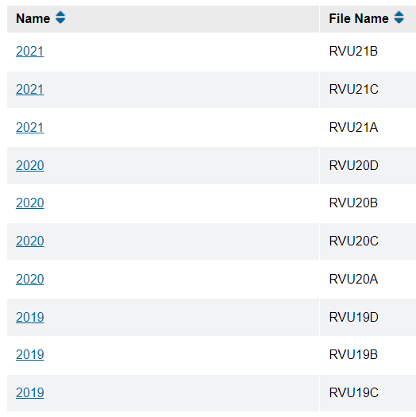
4. CPT Dataset
Similar to chargemasters, also had a mix of different files
Files used:
Part D (last quarter of year)
RVU files (Relative Value Units) in text format
Only extract first 2 columns

Slide 23
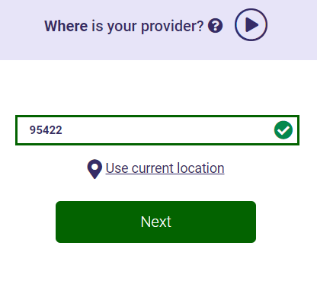
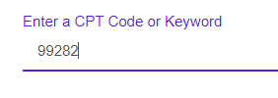
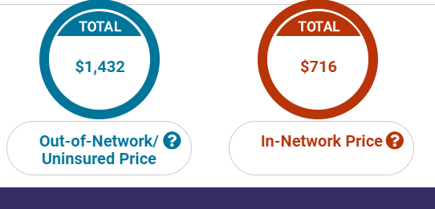
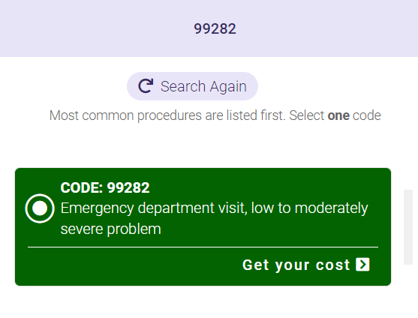
5. Patient Expenses Dateset
Process
Use Selenium to enter CPT and zip code to find the cost of a certain procedure in an area
Use BeautifulSoup to extract the in-network and out-of-network cost
Enter Zip Code
Enter CPT Code
Get Out-of-Network vs In-Network Price

Slide 24
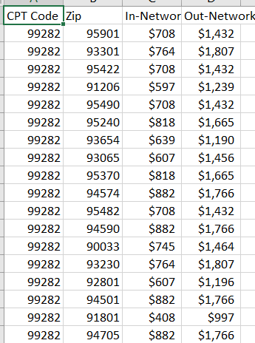
5. Patient Expenses Dateset (cont.)
DISCLAIMER: Website limited number of accesses to search tool. Therefore, only a small subset of patient expenses are used in this database.
Although limited, still wanted to include information to replicate the use of having this data available (Total should have been 58 million+ records)
Results: Cost of each procedure for each zip code (from hospital dataset)

Slide 25
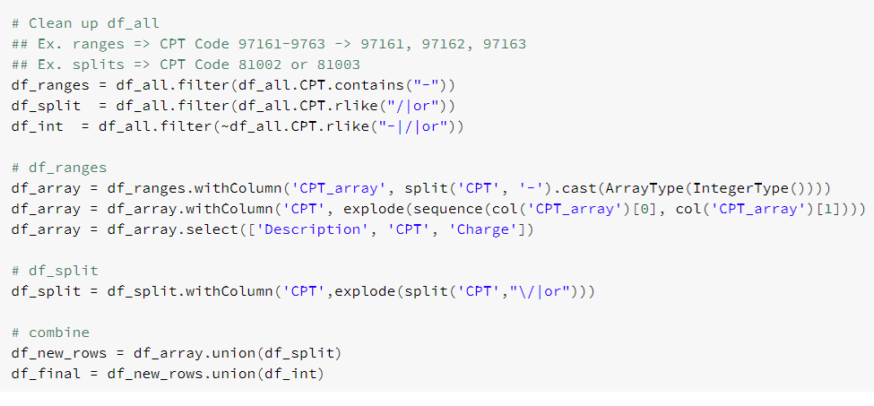
Migration to PySpark
To scale code to process more data (and faster) within Azure pipeline
Use built-in Spark function
Minimize UDFs to speed up processing
Convert lists and dataframes to Spark RDDs and Dataframes
Transfer code to Azure Databricks
Use PySpark filter function on RDD
Use PySpark dataframe functions

Slide 26
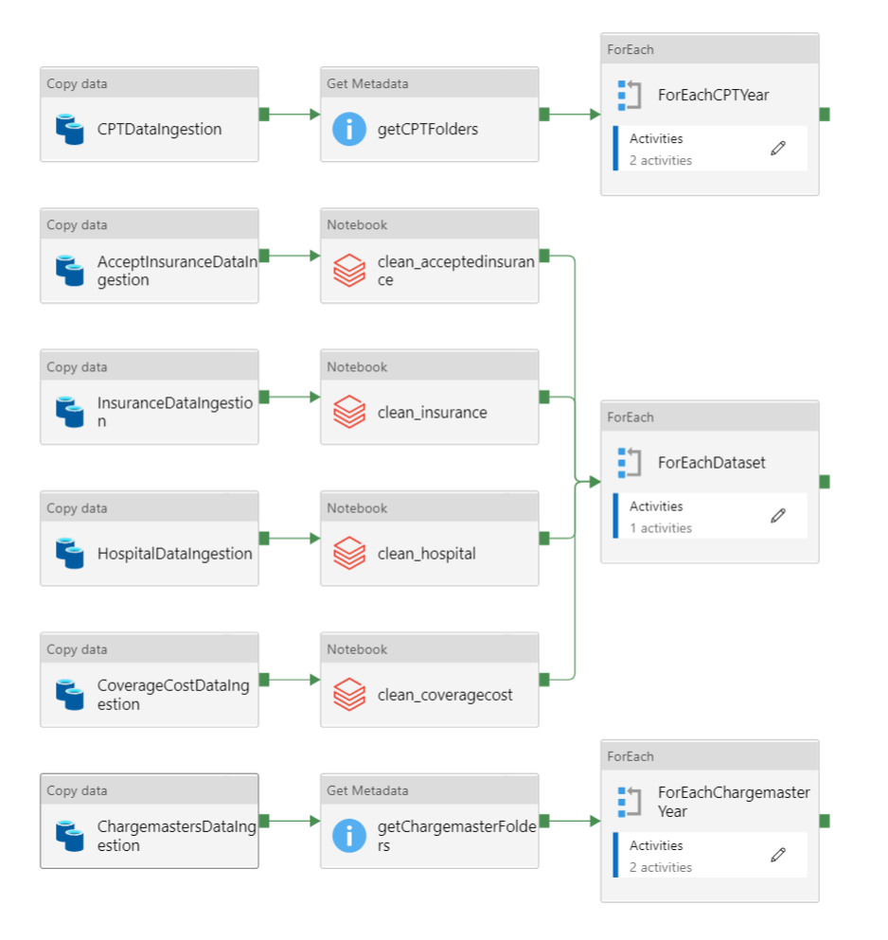
Data Pipeline
1
Each highlighted box runs separately but in parallel in the same pipeline.
Each separate data flow :
Ingests raw data from local drive
Copies data to Azure Blob Storage
Processes and cleans data into dataframes
Exports dataframes as parquet files in the same Blob Storage
Creates tables from each dataframe in Azure SQL Database
2
3

Slide 27
Test Suite
Function + Test Cases
Create Spark Session
Case 1: Spark Session can be started
Note: Does not accept parameters so no need to for edge cases
Connection to Blob Storage
Case 1: Connection to specific Blob Storage is successful
Note: Does not accept parameters so no need to for edge cases
Get Blob Data
Case 1: Get Blob data of csv file
Case 2: Get Blob data of excel file
Case 3: Get Blob data of non-existent file (expected error)
Download Blob Files:
Case 1: Download csv file from Blob storage
Case 2: Download excel file from Blob storage
Case 3: Download pdf file from Blob storage (expected error)

Slide 28
Test Suite (Cont.)
Read Blob Data
Case 1: Read csv file from Blob storage
Case 2: Read excel file from Blob storage
Case 3: Read non-existent file from Blob storage (expected error)
Exporting Files to Blob Storage
Case 1: Upload folder of files to Blob storage
Case 2: Upload local files to a non-existent Blob storage (expected error)
Case 3: Upload one file to Blob storage (expected error)
Get All Excel Sheet Names
Case 1: Read excel file of known sheet names
Case 2: Read empty excel file
Case 3: Read non-excel file
Get Excel Sheet Name of Target Form
Case 1: Read excel file with known target form sheet name
Case 2: Read excel file without target form
Case 3: Read non-excel file

Slide 29
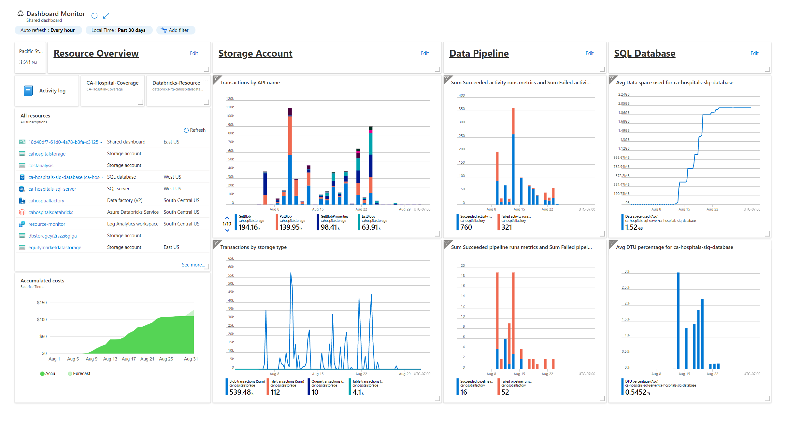
Dashboard
Resource Overview
List all resources used (w/ links)
Graph accumulated costs
Storage Account
Watch resource transactions
Watch storage capacity
Data Pipeline
Record each pipeline success vs failure
Record each pipeline activity success vs failure
SQL Database
Measure storage capacity
Measure CPU, memory, reads, and writes

